Slide 1
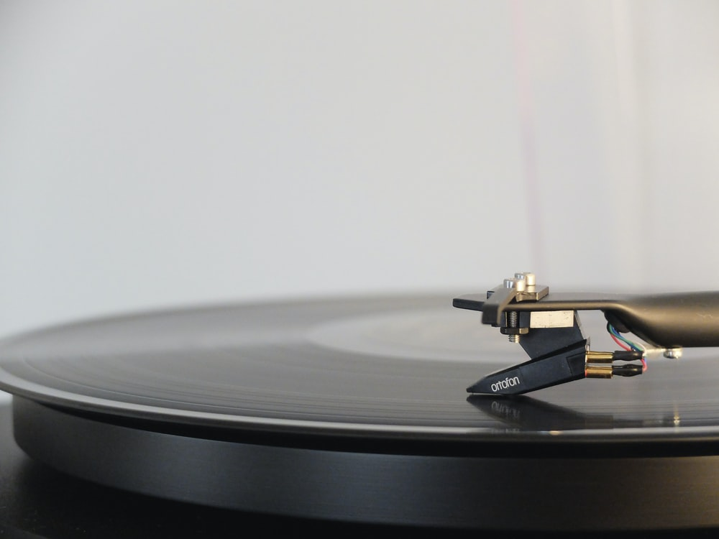

FREE MUSIC PLAYER
PREPARED BY-
BIKRAM BISWAS,KASHIF MUKHTAR
ROLL-NO:10400117173,10400118029

Slide 2

CONTENTS
TOPIC PAGE NO.
ACKNOWLEDGEMENT 3
INTRODUCTION 4
OBJECTIVE 5
FEATURES 6
DATA SET 7
QUERIES AND ARCHITECTURE 8-9
CHALLENGES 10
TOOLS AND LANGUAGES 11
CONCLUSION 12

Slide 3
ACKNOWLEDGEMENT
We must not forget to acknowledge everyone who has provided constant support to us during our B.Tech course. First and foremost, we would like to express sincere gratitude to our supervisor Prof. Eekian Wong for his continuous support and motivation in fueling the pursuance of carrying out this project endeavor. Without his guidance and persistent encouragement this project work would not have been possible. He has been a tremendous mentor for us throughout this academic journey. Many of his academic advises about our career growth have been priceless.
We would also like to thank our Director Prof. Satyajit Chakraborti for providing us an outstanding platform in order to develop our academic career. In addition, we also preserve a very special thankful feeling about our Principal Sir for being a constant source of inspiration

Slide 4
INTRODUCTION:
Music, without question, plays an important role in people’s way of life–in
religious rituals, ceremonies like graduation or marriage, social gatherings and
other cultural activities. People may make music as a hobby, or work as a
professional musician or singer.
Spotify is a digital music, podcast, and video service that gives you access to
millions of songs and other content from creators all over the world.Basic
functions such as playing music are totally free, but you can also choose to upgrade
to Spotify Premium.
Whether you have Premium or not, you can get recommendations based on your
taste, Build collections of music and podcasts,Spotify is available across a range of
devices, including computers, phones, tablets, speakers, TVs, and cars, and you
can easily transition from one to another with Spotify Connect.

Slide 5
OBJECTIVE:
Our objective is to explore Spotify api which contains millions of songs, podcasts,
episodes etc inside it through which we will make a music player that will call all
the metadata inside the Spotify api. This Music Player will get all the data related
to songs searched directly from the api and play that song.
Some of attributes we used in Spotify api are:-
I. getArtist
II. getCategories
III. getPlaylists
IV. getArtist’s Album
V. getTracks
VI. getPlayers
When we search about an artist or song in the Music Player’s search bar, the data is
automatically start fetching from the spotify api. the data contains image of the
songs , singers name and time of the songs etc. the user can listen those songs.

Slide 6
FEATURES & DESIGN:
Audio Features & Analysis:
With the Spotify Developer Platform, you’re able to read calculated audio features of tracks to learn about its danceability, energy, valence, and more. For more advanced use cases, it is possible to read in-depth analysis data about tracks such as the segments, tatums, bars, beats, pitches, and more.
Mood: Danceability, Valence, Energy, Tempo
Properties: Loudness, Speechiness, Instrumentalness
Context: Liveness, Acousticness
Segments, Tatums, Bars, Beats, Pitches, Timbre, and more
Playback:
Play music directly in the web browser, with the Web Playback SDK
Use Spotify Connect to control and transfer playback between any of a user’s active devices seamlessly.
With just a few lines of code, embed play widgets with Spotify’s look and feel

Slide 7
FEATURES & DESIGN:
Recommendations:
With specific controls - such as market, seeds (artists, genres, tracks), ranged audio features (danceability, valence, tempo, liveness, etc) and popularity, we can generate very specific recommendations based on Spotify’s powerful and industry-leading algorithms
Search:
Search and get information about any artist, album, track, or
playlist on Spotify based on a search query.
I.Search based on user’s market
II.Search based on fan following
III.Search up to top 100 results of Songs or tracks
Playlists:
I.Create, modify, view, delete, and set custom covers for user’s playlists.
II.Read User and Public Playlists, such as Discover Weekly and Release Radar
III.Read, Modify and Upload a Custom Cover for a User’s Public & Private Playlists
Add, Remove, and Reorder Tracks in a Playlist

Slide 8
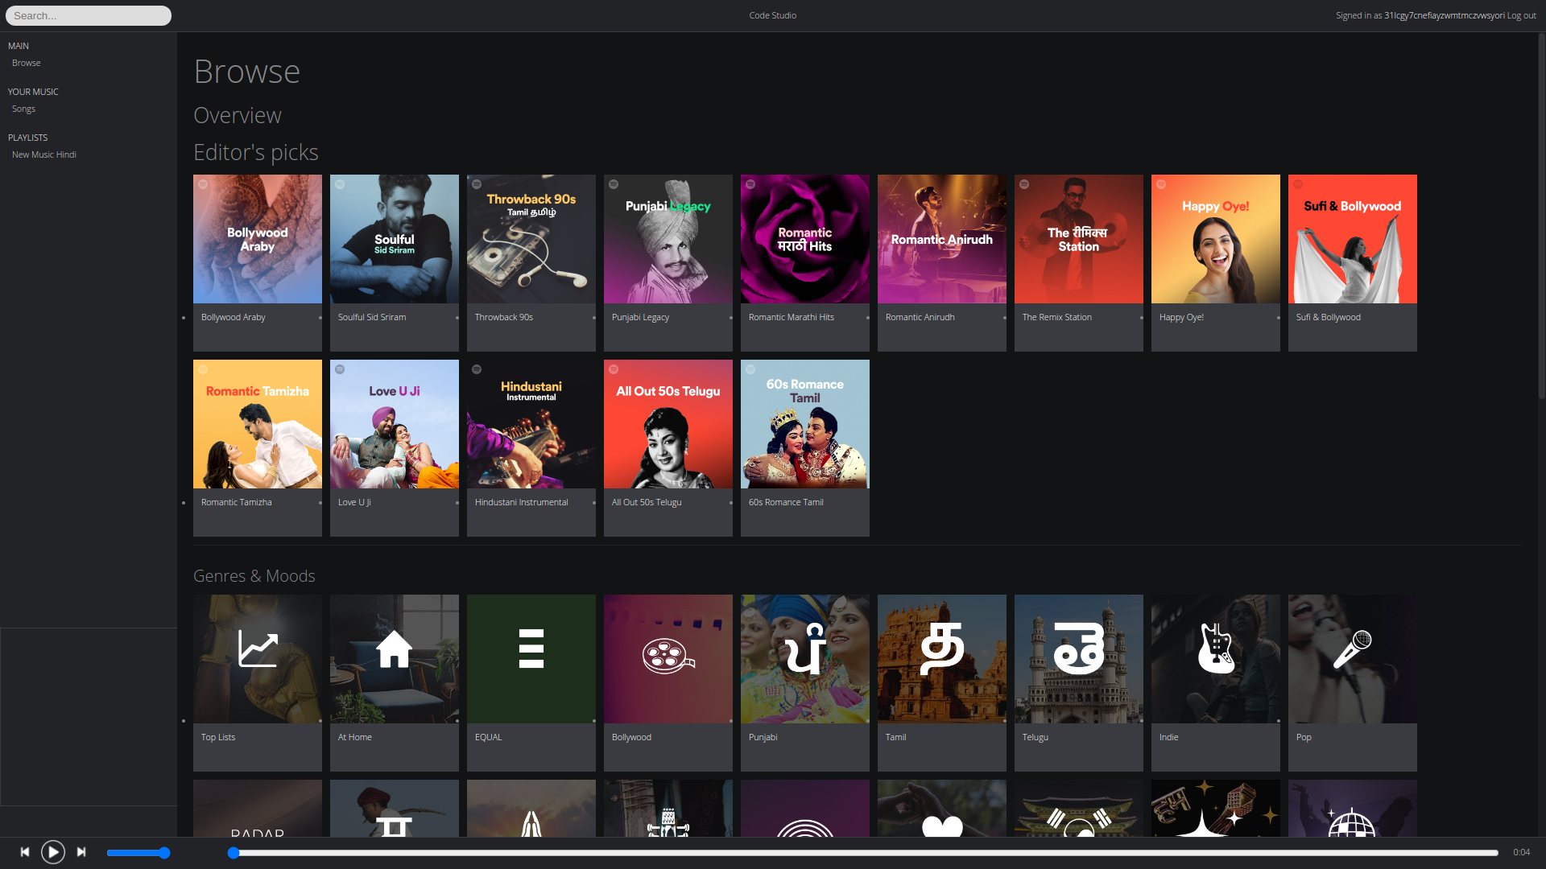

Slide 9
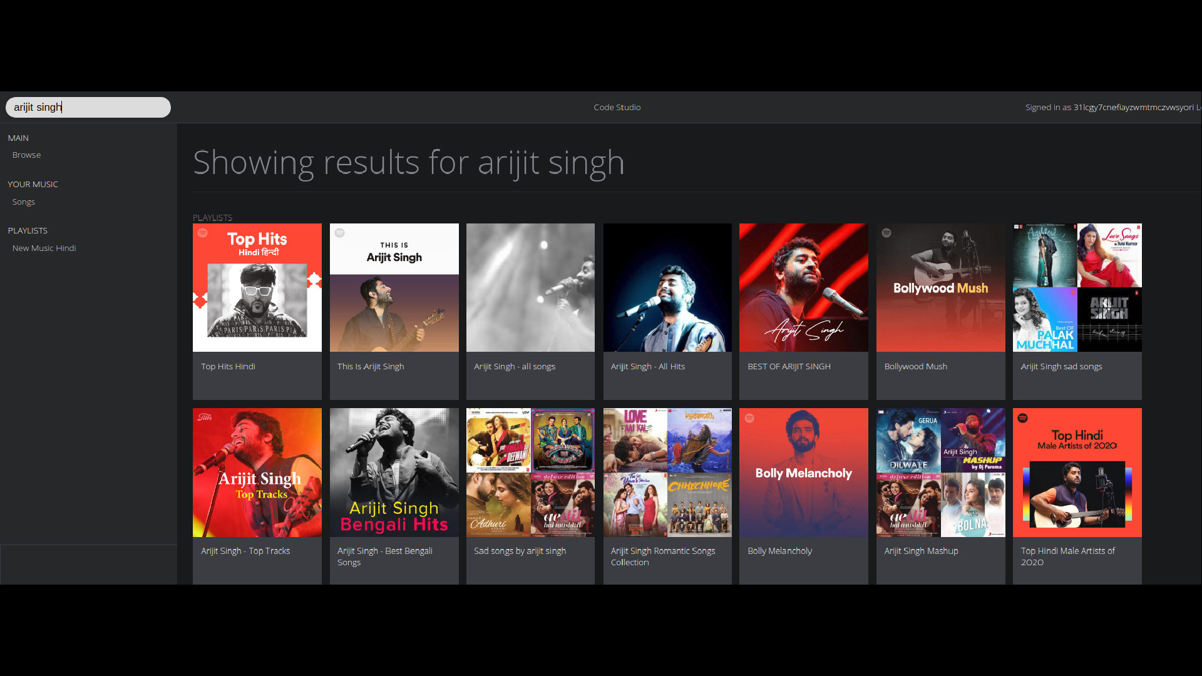
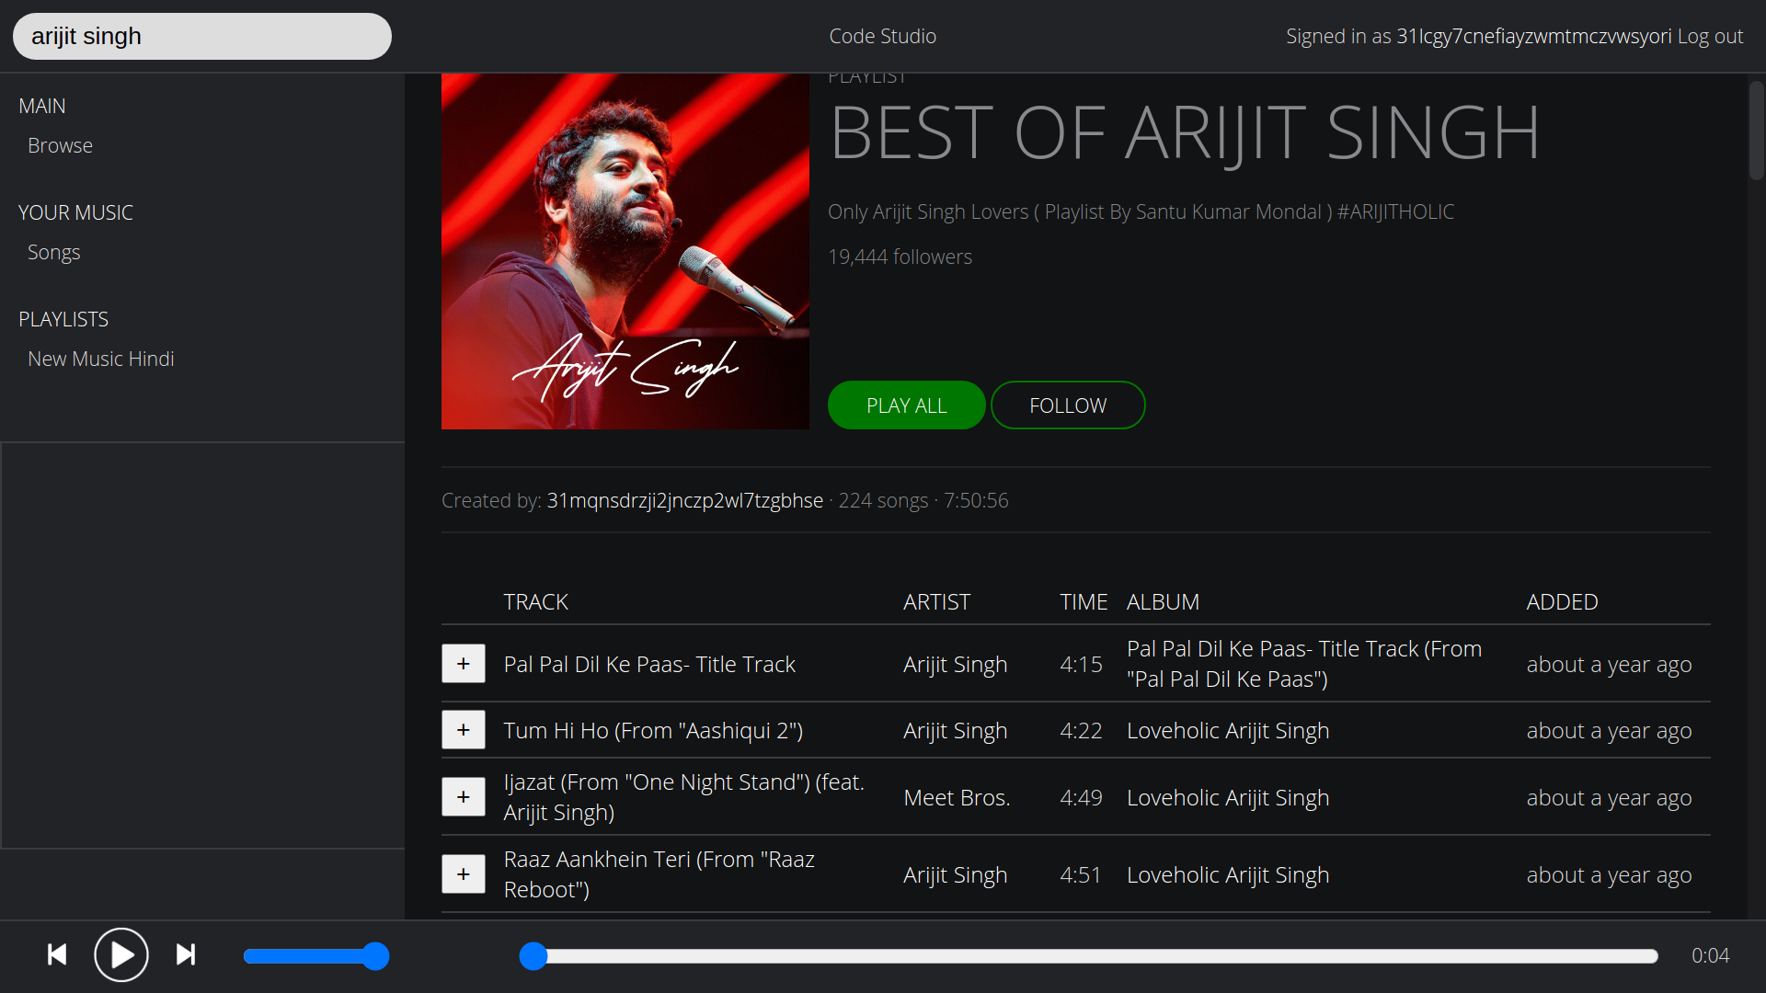
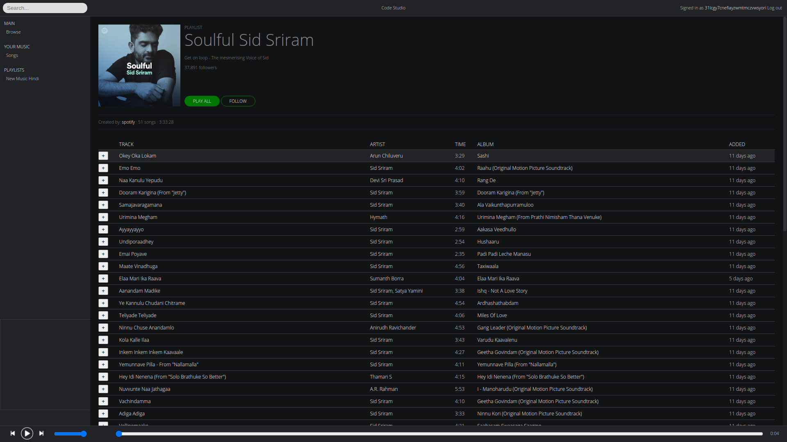

Slide 10

DATASET:
We utrilize a real time dataset crawled from google to give the
users the opportunity to interact and experience how the system
can be used for retrieving the music and songs
No noisy data ,such as incomplete or missing data
Live dataset obtained by using Spotify api
        The dataset consists of various types of attributes
        The attributes were divided into groups based on the query category
        Range category(Artists,Albums,Top tracks,Top songs,Podcast,Trailers etc)

Slide 11
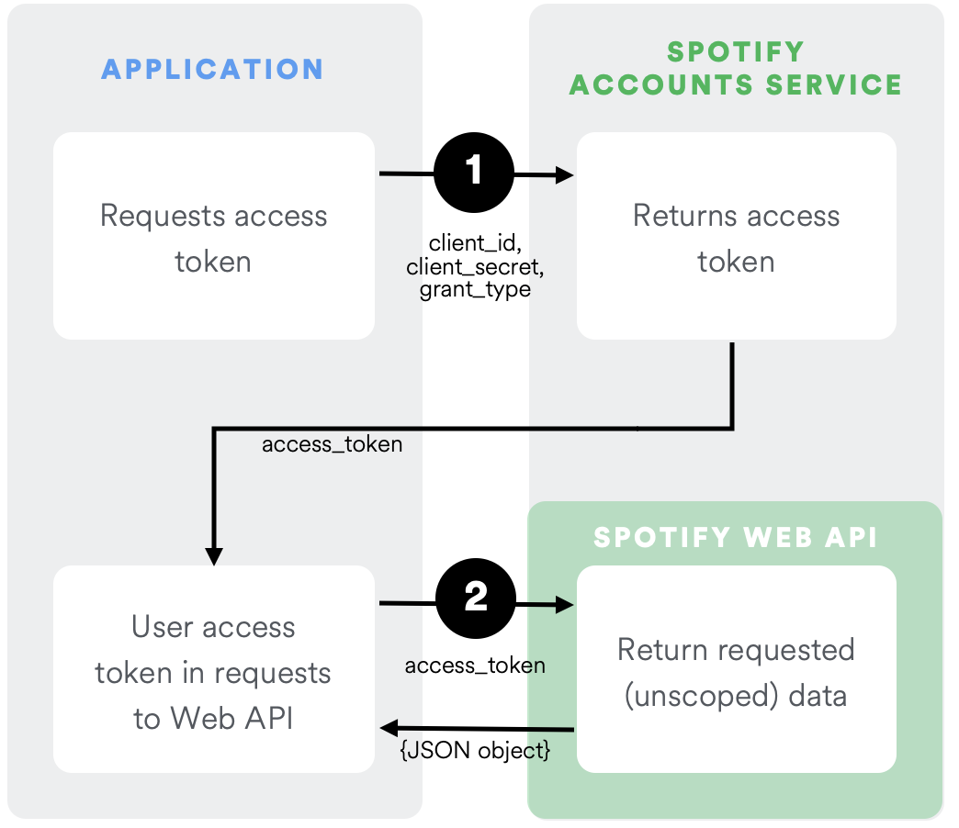
ARCHITECTURE:
Our API is what is commonly known as a Restful Api. Basically it is an interface
that programs can use to retrieve and manage Spotify data over the internet. The
Web API uses the same HTTP protocol that’s used by every internet browser. In
fact, you can access the API directly from your own browser.
Authoization
It’s easy to retrieve data through the Web API but what about retrieving personal
data about a user and managing that data? In this case we need to be a bit more
careful. For one thing we need to securely identify the user and for another we
need to get the user’s permission to access and manipulate their data. In this case
we must use OAuth (an open standard for authorization) to get the job done.

Slide 12
ARCHITECTURE:
Along with the call, the program passes along a list of “scopes“.
The scopes define both what user data that the program wants to access and what it
wants to do with that data. In response, the Spotify Accounts service displays to
the user a list of the data that the program wants access to, based on the scopes.
(The Spotify Accounts service also prompts the user to log in to Spotify, if
necessary.)
When the user clicks “Okay”, the Spotify Accounts service returns to the
developer’s program via a previously supplied callback address, passing a
temporary code. The program can now use that code, along with its Client ID and
Client secret, in a second call to the Spotify Accounts service to get an access
token

Slide 13
Challenges:
I.
. Integration:
Spotify api
Data analysis
sFeature selection
Primary features
Secondary features
3.Quality testing

Slide 14
:
TOOLS & LANGUAGES:
HTML,CSS ,JAVASCRIPT(FRONT_END)
NODE_JS(BACKEND)
JSON
SPOTIFY WEB API
GITHUB

Slide 15
CONCLUSION
.
The purpose of the project is to understand and explore the Spotify Api. And how
to integrate and fetch data from the Api. We understand the way how Api works
and how can we directly call the Api to get the desired data. We have come to
understand different technologies and frameworks such as angular, css, html,
javascript, nodejs for making the music player and fetching the data from the
spotify api.
Still there are lot more to learn as there are lot more other metadata present in the
Spotify Api that we still have’nt used.
The function that we add in future are the adding podcast, episodes into the
application and also adding new released songs and tracks on the homepage screen
then we can also add a function that can keep a track of users past played songs
and user’s favourites playlist.

Slide 16
THANK YOU

